Slide 1
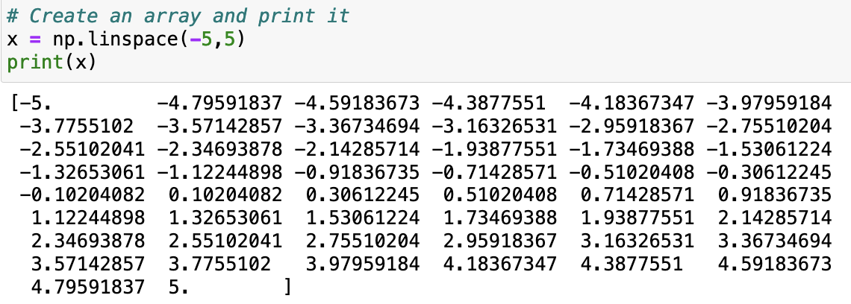
np.linspace
np.linspace is a numpy function that allows you to create an array of numbers between specified bounds. Here’s an example:

Slide 2
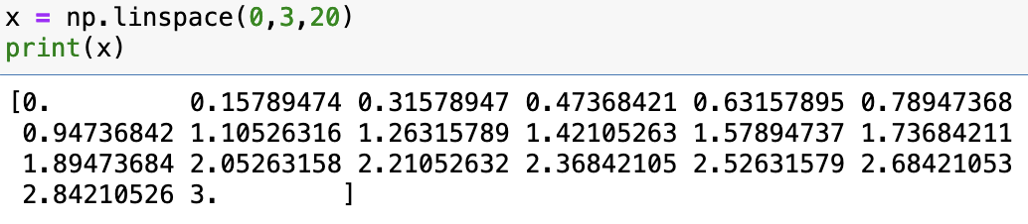
np.linspace
The default number of points if 50. You can change that by adding a third argument:

Slide 3
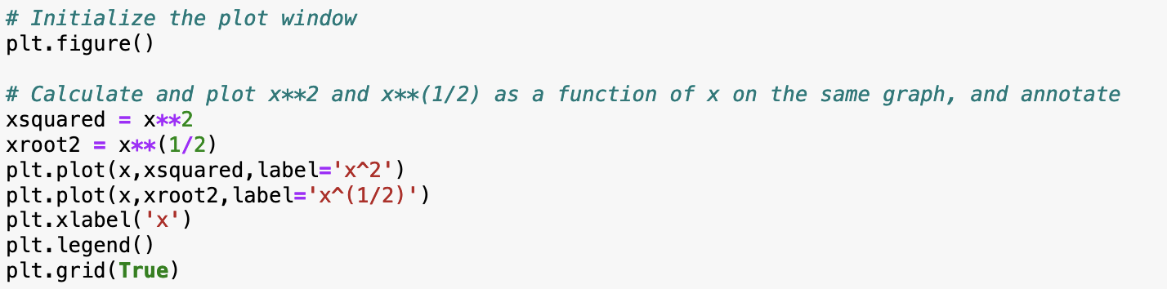
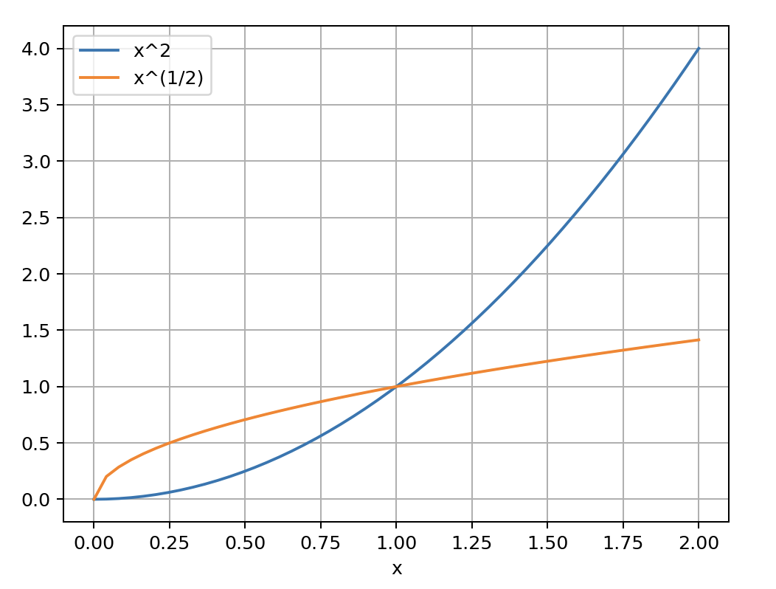
The label/legend technique for plotting multiple curves on one graph

Slide 4
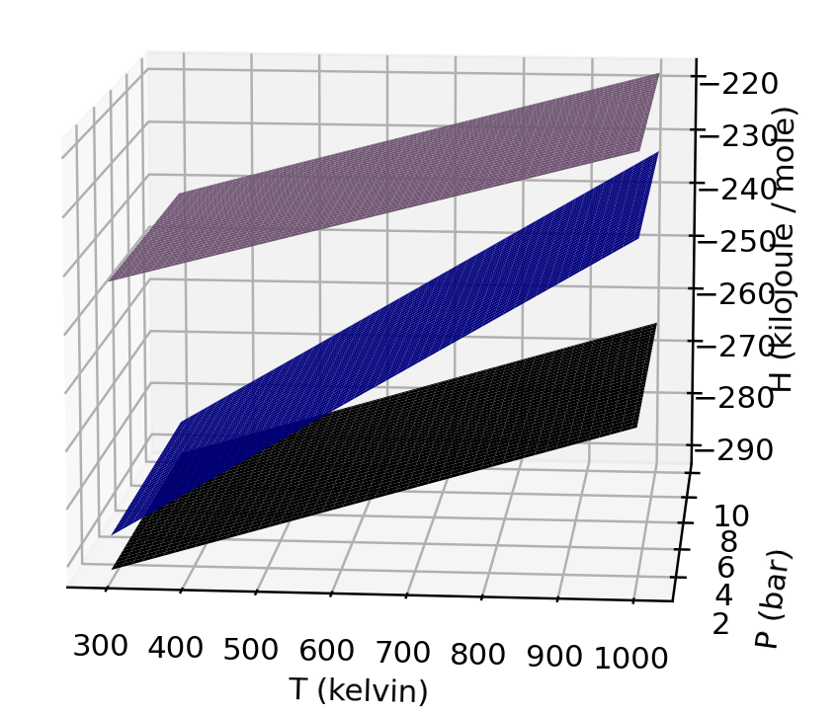
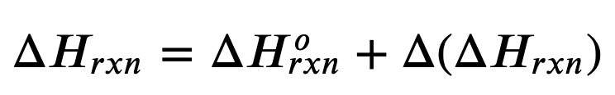

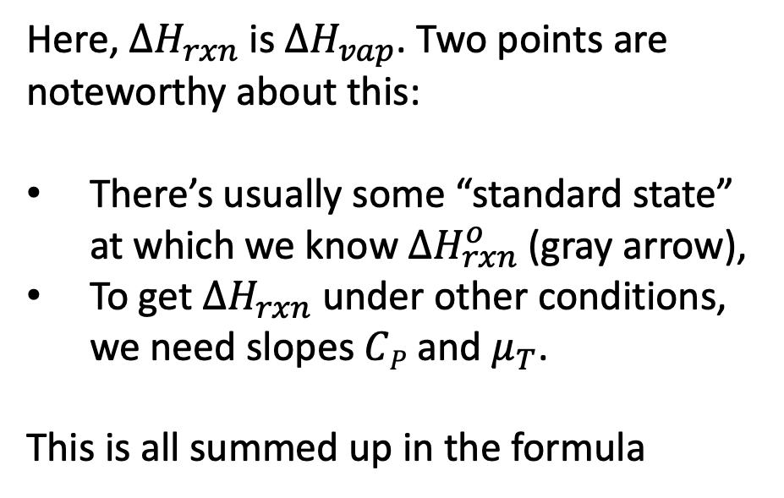

$∆H_{rxn}$ depends on the initial and final states, as well as the temperature and pressure
Here, $ΔH_{rxn}$ is $ΔH_{vap}$. Two points are noteworthy about this:
There’s usually some “standard state” at which we know $ΔH_{rxn}^{o}$ (gray arrow),
To get $ΔH_{rxn}$ under other conditions, we need slopes $CP$ and $μ_{T}$.
This is all summed up in the formula
gas
liquid
$$ΔH_{vap}$$
$$ΔH_{vap}^{o}$$
solid

Slide 5
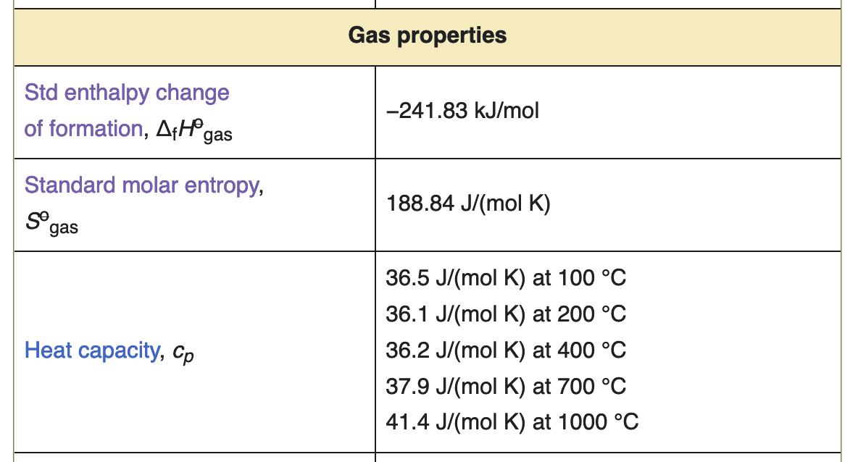
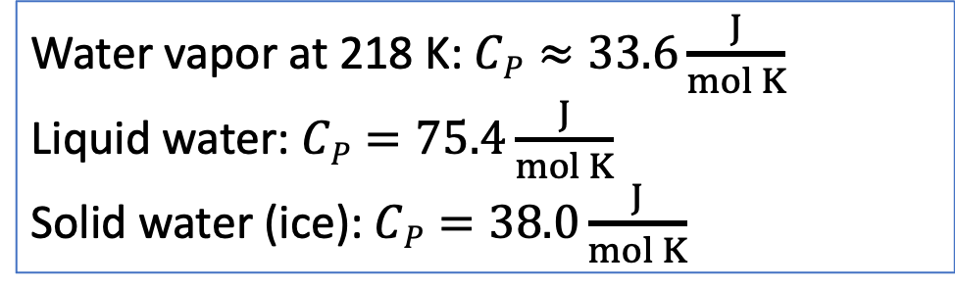
A challenge is that these slopes also vary with temperature and pressure
https://en.wikipedia.org/wiki/Water_(data_page)
For the temperatures used in the CGI, we’ll use these approximations. If you find other values in the literature, they’re probably also fine.
Water vapor at 218 K:$CP≈33.6\frac{J}{mol K}$
Liquid water:$CP=75.4\frac{J}{mol K}$
Solid water (ice): $CP=38.0\frac{J}{mol K}$

Slide 6



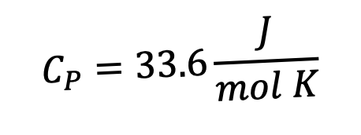

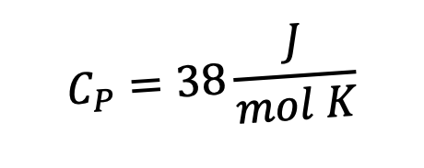

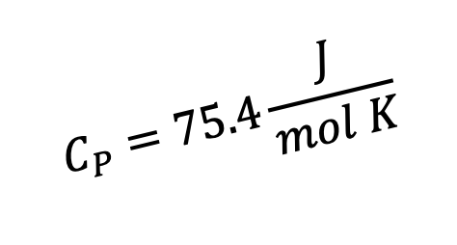

Managing expectations for $∆H_{rxn}$ at different temperatures
$$C_{P}=33.6\frac{J}{mol K}$$
$$ΔH_{vap}$$
$$45.1\frac{kJ}{mol}$$
$$C_{P}=75.4\frac{J}{mol K}$$
H
$$ΔH_{sub}$$
$$51.1\frac{kJ}{mol}$$
$$ΔH_{fus}$$
$$6.0\frac{kJ}{mol}$$
$$C_{P}=38\frac{J}{mol K}$$
273 K
T
Clearly, the enthalpy of sublimation equals the sum of the enthalpies of fusion and vaporization (at a given temperature).

Slide 7
Managing expectations for $∆H_{rxn}$ at different temperatures
$$C_{P}=33.6\frac{J}{mol K}$$
$$ΔH_{vap}$$
$$45.1\frac{kJ}{mol}$$
$$C_{P}=75.4\frac{J}{mol K}$$
H
$$ΔH_{sub}$$
$$51.1\frac{kJ}{mol}$$
$$ΔH_{fus}$$
$$6.0\frac{kJ}{mol}$$
$$C_{P}=38\frac{J}{mol K}$$
273 K
T
What happens to $ΔH_{fus}$ at a lower temperature (like in the Arctic Ocean)?
What happens to $ΔH_{sub}$ at a (much) lower temperature (like on Mars!)?

Slide 8
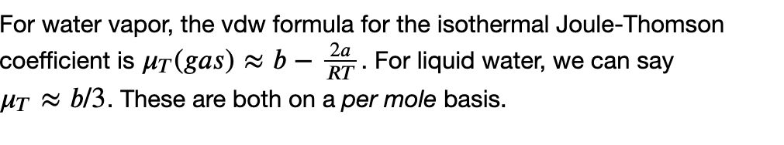
Managing expectations for $∆H_{rxn}$ at different pressures
B
A
What happens to $ΔH_{vap}$ at a higher pressure (and room temperature)?

Slide 9
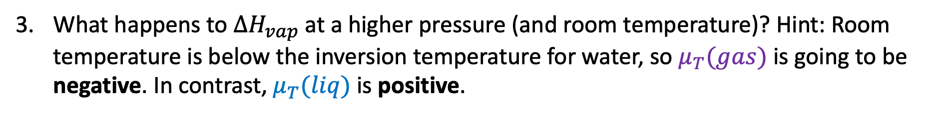
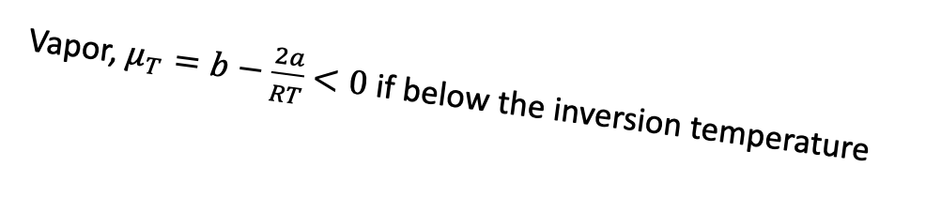
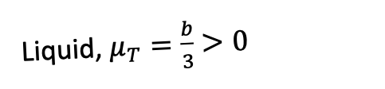
Managing expectations for $∆H_{rxn}$ at different pressures
Vapor, $μ_{T}=b−\frac{2a}{RT}$ $<0$ if below the inversion temperature
Liquid, $μ_{T}=\frac{b}{3}$ $>0$
B
A
P -->
B
A
What happens to $ΔH_{vap}$ at a higher pressure (and room temperature)? Hint: Room temperature is below the inversion temperature for water, so $μ_{T}(gas)$ is going to be negative. In contrast, $μ_{T}(liq)$ is positive.

Slide 10
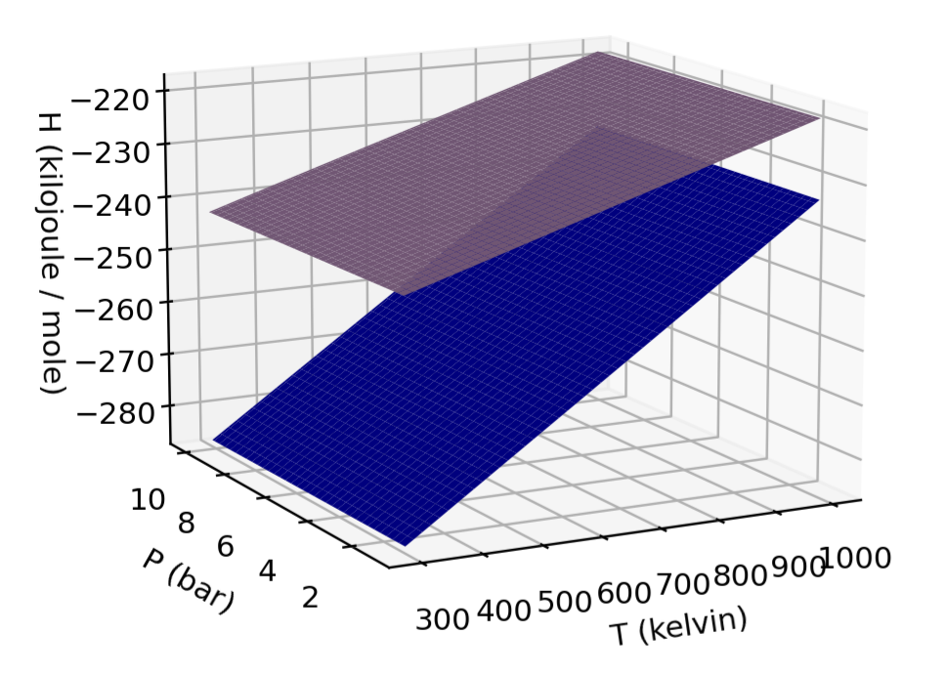
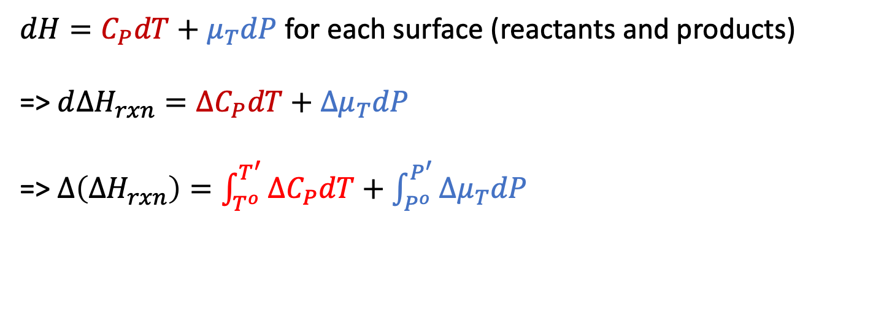




Kirchoff’s Law (quantitative version of what we just talked about)
Kirchoff’s Law is all about finding $∆H_{rxn}$ at a new temperature & pressure
$dH=C_{P}dT+μ_{T}dP$ for each surface (reactants and products)
=> $d∆H_{rxn}=∆C_{P}dT+{∆μ}_{T}dP$
=> $∆\left(∆H_{rxn}\right)=\int_{T^{o}}^{T^{′}}{{∆C}_{P}dT}+\int_{P^{o}}^{P^{′}}{{∆μ}_{T}dP}$
${∆C}_{P}=C_{P}^{products}−C_{P}^{reactants}$
$$products$$
$$reactants$$
$${∆μ}_{T}=μ_{T}^{products}−μ_{T}^{reactants}$$

Slide 11
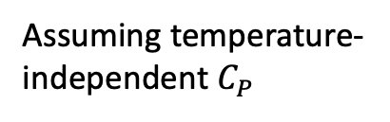
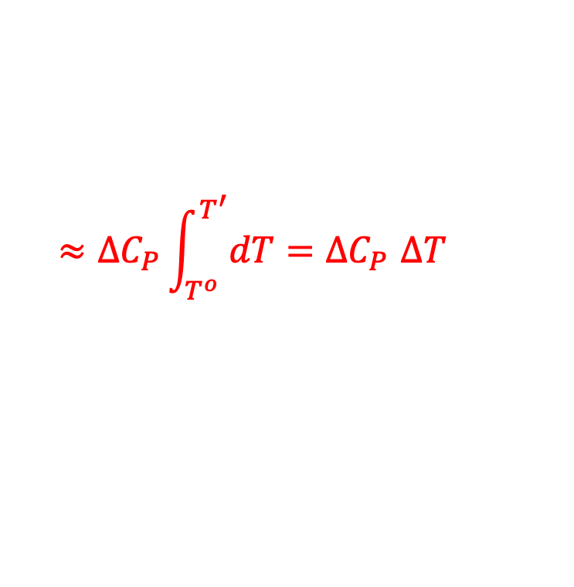
Kirchoff’s Law (quantitative version of what we just talked about)
Kirchoff’s Law is all about finding $∆H_{rxn}$ at a new temperature & pressure
$dH=C_{P}dT+μ_{T}dP$ for each surface (reactants and products)
=> $d∆H_{rxn}=∆C_{P}dT+{∆μ}_{T}dP$
=> $∆\left(∆H_{rxn}\right)=\int_{T^{o}}^{T^{′}}{{∆C}_{P}dT}+\int_{P^{o}}^{P^{′}}{{∆μ}_{T}dP}$
${∆C}_{P}=C_{P}^{products}−C_{P}^{reactants}$
$$products$$
Assuming temperature-independent $C_{P}$
$$reactants$$
$$≈{∆C}_{P}\int_{T^{o}}^{T^{′}}{dT}{=∆C}_{P}∆T$$
$${∆μ}_{T}=μ_{T}^{products}−μ_{T}^{reactants}$$

Slide 12
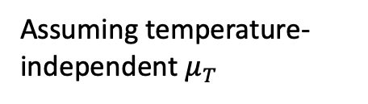
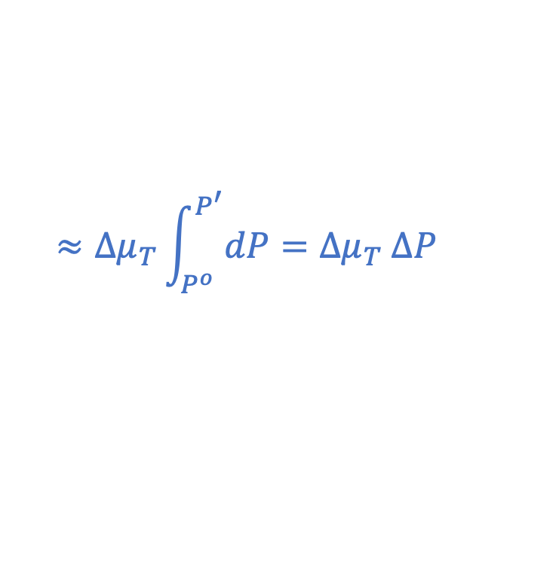
Kirchoff’s Law (quantitative version of what we just talked about)
Kirchoff’s Law is all about finding $∆H_{rxn}$ at a new temperature & pressure
$dH=C_{P}dT+μ_{T}dP$ for each surface (reactants and products)
=> $d∆H_{rxn}=∆C_{P}dT+{∆μ}_{T}dP$
=> $∆\left(∆H_{rxn}\right)=\int_{T^{o}}^{T^{′}}{{∆C}_{P}dT}+\int_{P^{o}}^{P^{′}}{{∆μ}_{T}dP}$
${∆C}_{P}=C_{P}^{products}−C_{P}^{reactants}$
Assuming temperature-independent $μ_{T}$
$$products$$
$$≈{∆μ}_{T}\int_{P^{o}}^{P^{′}}{dP}={∆μ}_{T} ∆P$$
$$reactants$$
$$≈{∆C}_{P}\int_{T^{o}}^{T^{′}}{dT}{=∆C}_{P}∆T$$
$${∆μ}_{T}=μ_{T}^{products}−μ_{T}^{reactants}$$

